Slide 1
Chapter 9 – Elliptic Curve Cryptography
ver. February 2nd, 2015
These slides were prepared by Tim Güneysu, Christof Paar and Jan Pelzl
Notes:
‹#›

Slide 2
Some legal stuff (sorry): Terms of Use
The slides can be used free of charge. All copyrights for the slides remain with Christof Paar and Jan Pelzl.
The title of the accompanying book “Understanding Cryptography” by Springer and the author’s names must remain on each slide.
If the slides are modified, appropriate credits to the book authors and the book title must remain within the slides.
It is not permitted to reproduce parts or all of the slides in printed form whatsoever without written consent by the authors.
‹#›/24
Chapter 9 of Understanding Cryptography by Christof Paar and Jan Pelzl

Slide 3
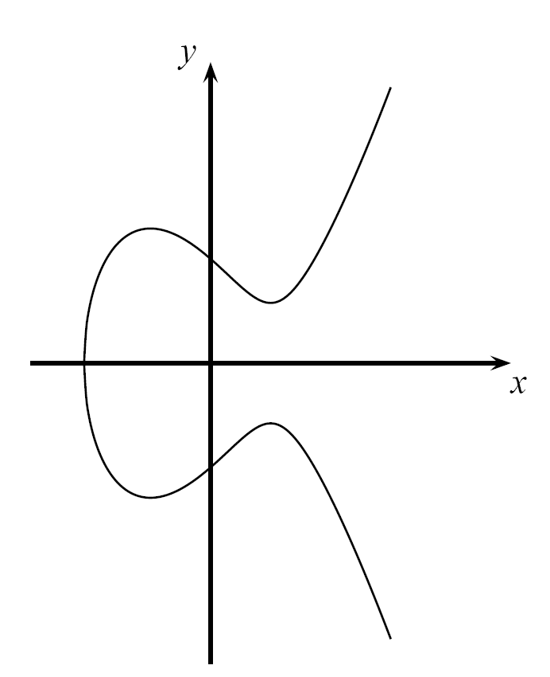
Content of this Chapter
Introduction
Computations on Elliptic Curves
The Elliptic Curve Diffie-Hellman Protocol
Security Aspects
Implementation in Software and Hardware
‹#›/24
Chapter 9 of Understanding Cryptography by Christof Paar and Jan Pelzl

Slide 4
Content of this Chapter
Introduction
Computations on Elliptic Curves
The Elliptic Curve Diffie-Hellman Protocol
Security Aspects
Implementation in Software and Hardware
‹#›/24
Chapter 9 of Understanding Cryptography by Christof Paar and Jan Pelzl

Slide 5
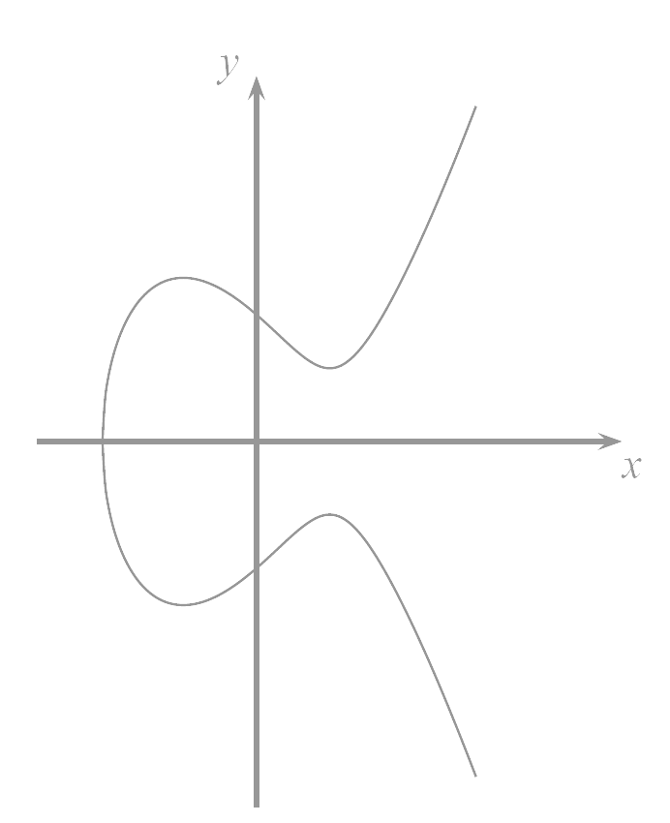
Motivation
Problem: Asymmetric schemes like RSA and Elgamal require exponentiations in integer rings and fields with parameters of more than 1000 bits.
High computational effort on CPUs with 32-bit or 64-bit arithmetic
Large parameter sizes critical for storage on small and embedded
Motivation: Smaller field sizes providing equivalent security are desirable
Solution: Elliptic Curve Cryptography uses a group of points (instead of integers) for cryptographic schemes with coefficient sizes of 160-256 bits, reducing significantly the computational effort.
‹#›/24
Chapter 9 of Understanding Cryptography by Christof Paar and Jan Pelzl
Notes:
‹#›

Slide 6
Content of this Chapter
Introduction
Computations on Elliptic Curves
The Elliptic Curve Diffie-Hellman Protocol
Security Aspects
Implementation in Software and Hardware
‹#›/24
Chapter 9 of Understanding Cryptography by Christof Paar and Jan Pelzl

Slide 7

Computations on Elliptic Curves
Elliptic curves are polynomials that define points based on the (simplified) Weierstraß equation:
y² = x³ + ax + b
for parameters a,b that specify the exact shape of the curve
On the real numbers and with parameters a, b R, an elliptic curve looks like this 🡪
Elliptic curves can not just be defined over the real numbers R but over many other types of finite fields.
Example: y² = x³ −3x+3 over R
‹#›/24
Chapter 9 of Understanding Cryptography by Christof Paar and Jan Pelzl

Slide 8


Computations on Elliptic Curves (ctd.)
In cryptography, we are interested in elliptic curves module a prime p:
Note that Z_{p} = {0,1,…, p -1} is a set of integers with modulo p arithmetic
Definition: Elliptic Curves over prime fields
The elliptic curve over Z_{p}, p>3 is the set of all pairs (x,y) Z_{p} which fulfill y² = x³ + ax + b mod p together with an imaginary point of infinity θ, where a,b Z_{p} and the condition 4a³+27b² ≠ 0 mod p.
‹#›/24
Chapter 9 of Understanding Cryptography by Christof Paar and Jan Pelzl
Notes:
‹#›

Slide 9
Computations on Elliptic Curves (ctd.)
Some special considerations are required to convert elliptic curves into a group of points
In any group, a special element is required to allow for the identity operation, i.e., given P E: P + θ = P = θ + P
This identity point (which is not on the curve) is additionally added to the group definition
This (infinite) identity point is denoted by θ
Elliptic Curve are symmetric along the x-axis
Up to two solutions y and -y exist for each quadratic residue x of the elliptic curve
For each point P =(x,y), the inverse or negative point is defined as -P =(x,-y)
P
point at
infinity
θ
-P
‹#›/24
Chapter 9 of Understanding Cryptography by Christof Paar and Jan Pelzl
Notes:
‹#›

Slide 10

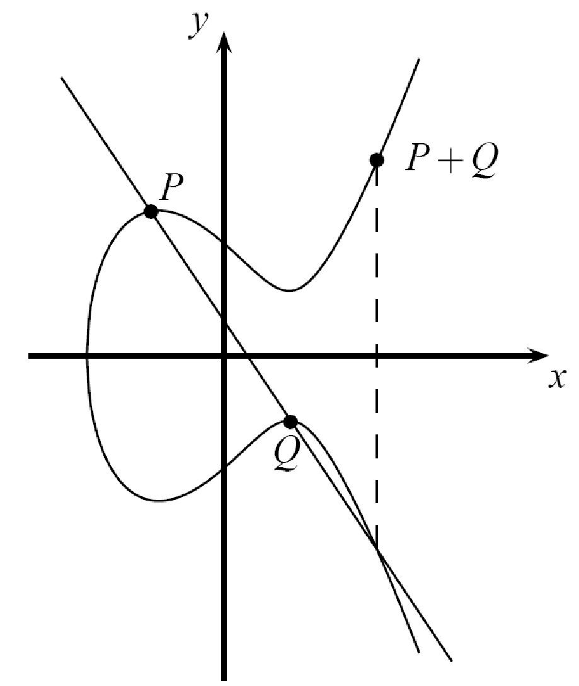
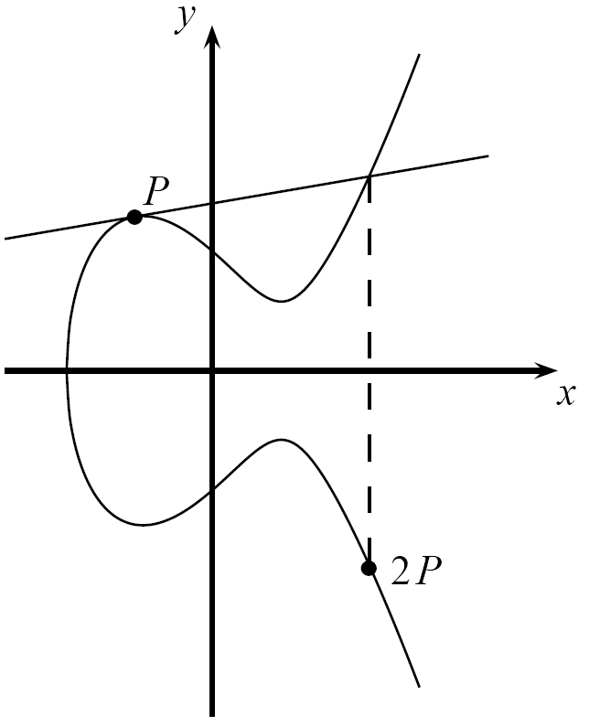
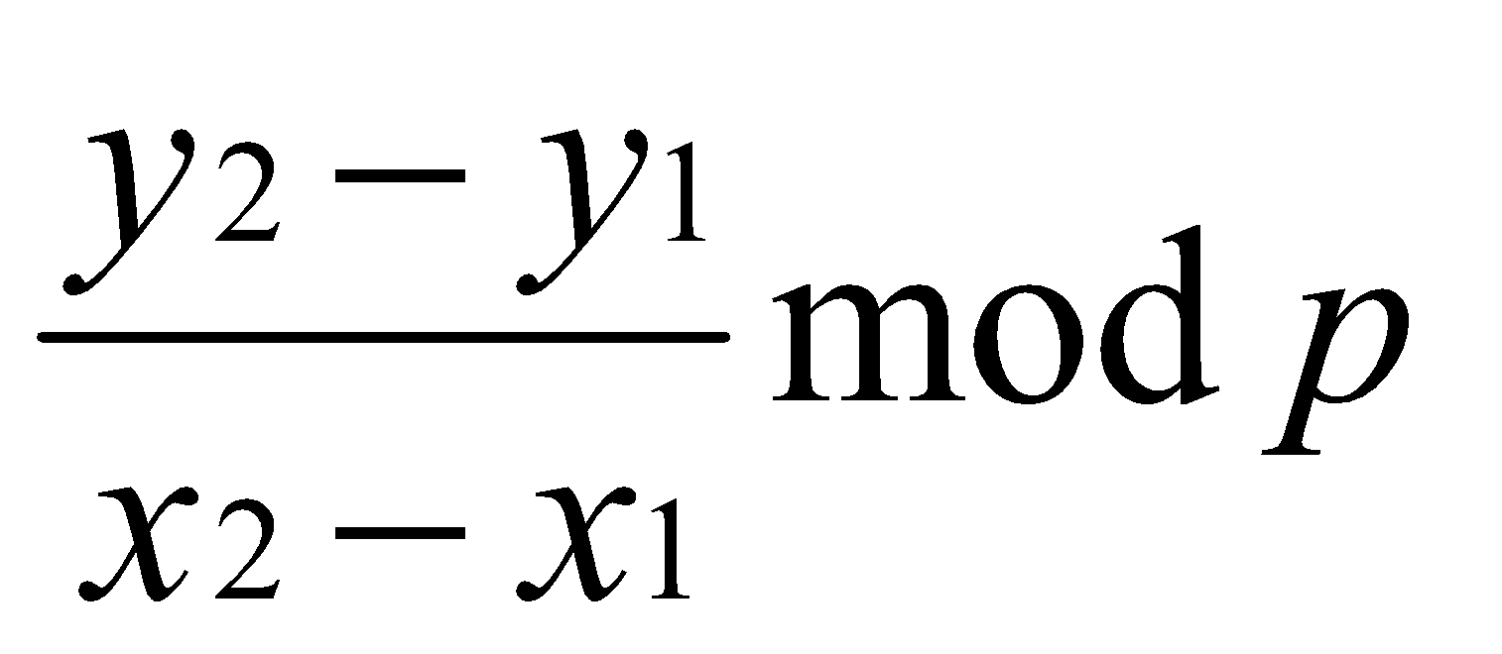
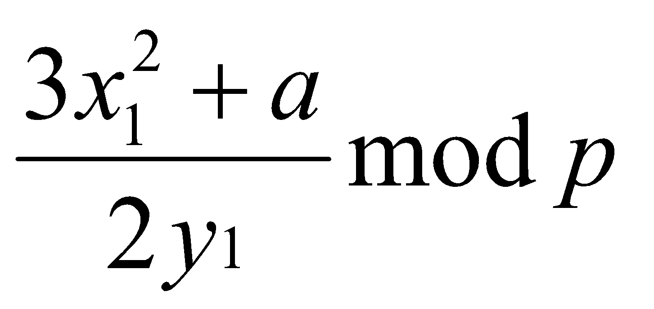
Computations on Elliptic Curves (ctd.)
Generating a group of points on elliptic curves based on point addition operation P+Q = R, i.e., (x_{P},y_{P})+(x_{Q},y_{Q}) = (x_{R},y_{R})
Geometric Interpretation of point addition operation
Draw straight line through P and Q; if P=Q use tangent line instead
Mirror third intersection point of drawn line with the elliptic curve along the x-axis
Elliptic Curve Point Addition and Doubling Formulas
Point Addition
x₃ = s² −x₁−x₂ mod p and y₃ = s(x₁ −x₃)−y₁ mod p
where
s =
Point Doubling
; if P ≠ Q (point addition)
; if P = Q (point doubling)
=P+P
‹#›/24
Chapter 9 of Understanding Cryptography by Christof Paar and Jan Pelzl
Notes:
‹#›

Slide 11
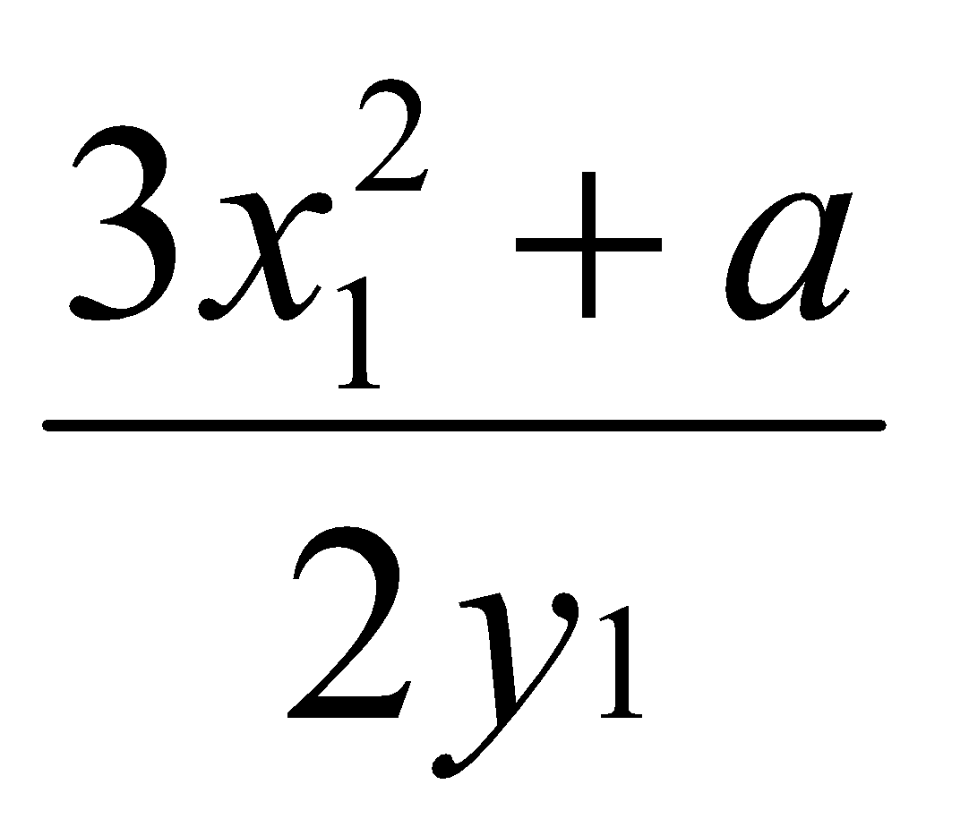
Computations on Elliptic Curves (ctd.)
Example: Given E: y² = x³+2x+2 mod 17 and point P=(5,1) Goal: Compute 2P = P+P = (5,1)+(5,1)= (x₃,y₃)
s = = (2 · 1)⁻¹(3 · 5² + 2) = 2⁻¹ · 9 ≡ 9 · 9 ≡ 13 mod 17
x₃ = s² − x₁ − x₂ = 13² − 5 − 5 = 159 ≡ 6 mod 17 y₃ = s(x₁−x₃) − y₁ = 13(5 − 6) − 1= −14 ≡ 3 mod 17
Finally 2P = (5,1) + (5,1) = (6,3)
‹#›/24
Chapter 9 of Understanding Cryptography by Christof Paar and Jan Pelzl

Slide 12
Computations on Elliptic Curves (ctd.)
The points on an elliptic curve and the point at infinity θ form cyclic subgroups 2P = (5,1)+(5,1) = (6,3) 11P = (13,10) 3P = 2P+P = (10,6) 12P = (0,11) 4P = (3,1) 13P = (16,4) 5P = (9,16) 14P = (9,1) 6P = (16,13) 15P = (3,16) 7P = (0,6) 16P = (10,11) 8P = (13,7) 17P = (6,14) 9P = (7,6) 18P = (5,16) 10P = (7,11) 19P = θ
This elliptic curve has order #E = |E| = 19 since it contains 19 points in its cyclic group.
P
θ
‹#›/24
Chapter 9 of Understanding Cryptography by Christof Paar and Jan Pelzl

Slide 13
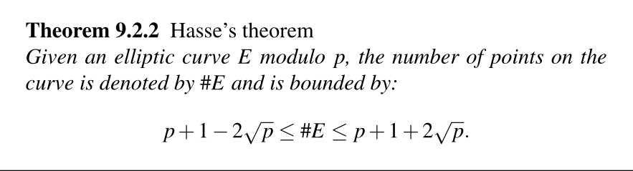
Number of Points on an Elliptic Curve
How many points can be on an arbitrary elliptic curve?
Consider previous example: E: y² = x³+2x+2 mod 17 has 19 points
However, determining the point count on elliptic curves in general is hard
But Hasse‘s theorem bounds the number of points to a restricted interval
Interpretation: The number of points is close to the prime p
Example: To generate a curve with about 2¹⁶⁰ points, a prime with a length of about 160 bits is required
‹#›/24
Chapter 9 of Understanding Cryptography by Christof Paar and Jan Pelzl

Slide 14
Elliptic Curve Discrete Logarithm Problem
Cryptosystems rely on the hardness of the Elliptic Curve Discrete Logarithm Problem (ECDLP)
Definition: Elliptic Curve Discrete Logarithm Problem (ECDLP)
Given a primitive element P and another element T on an elliptic curve E. The ECDL problem is finding the integer d, where 1 ≤ d ≤ #E such that P + P +…+ P = dP = T.
d times
Cryptosystems are based on the idea that d is large and kept secret and attackers cannot compute it easily
If d is known, an efficient method to compute the point multiplication dP is required to create a reasonable cryptosystem
Known Square-and-Multiply Method can be adapted to Elliptic Curves
The method for efficient point multiplication on elliptic curves: Double-and-Add Algorithm
‹#›/24
Chapter 9 of Understanding Cryptography by Christof Paar and Jan Pelzl

Slide 15
Elliptic Curve Discrete Logarithm Problem
Why it is hard to calculate?
On normal numbers, we can:
If y = g^{x} (mod p) we can solve for x using logarithms
On elliptic curves, there’s no simple algorithms.
The best known algorithms for ECDLP require about √n steps, where n is the order of G
If n is ~2²⁵⁶ then solving takes about 2¹²⁸ operations which in infeasible.
‹#›/24
Chapter 9 of Understanding Cryptography by Christof Paar and Jan Pelzl

Slide 16
Content of this Chapter
Introduction
Computations on Elliptic Curves
The Elliptic Curve Diffie-Hellman Protocol
Security Aspects
Implementation in Software and Hardware
‹#›/24
Chapter 9 of Understanding Cryptography by Christof Paar and Jan Pelzl

Slide 17

The Elliptic Curve Diffie-Hellman Key Exchange (ECDH)
Given a prime p, a suitable elliptic curve E and a point P=(x_{P},y_{P})
The Elliptic Curve Diffie-Hellman Key Exchange is defined by the following protocol:
Joint secret between Alice and Bob: T_{AB} = (x_{AB}, y_{AB})
Proof for correctness:
Alice computes aB=a(bP)=abP
Bob computes bA=b(aP)=abP since group is associative
One of the coordinates of the point T_{AB} (usually the x-coordinate) can be used as session key (often after applying a hash function)
Alice
Choose k_{PrA}= a {2, 3,…, #E-1}
Compute k_{PubA}= A = aP = (x_{A},y_{A})
Compute aB = T_{ab}
Bob
Choose k_{PrB}= b {2, 3,…, #E-1}
Compute k_{PubB}= B = bP = (x_{B},y_{B})
Compute bA = T_{ab}
A
B
‹#›/24
Chapter 9 of Understanding Cryptography by Christof Paar and Jan Pelzl

Slide 18
The Elliptic Curve Diffie-Hellman Key Exchange (ECDH) (ctd.)
The ECDH is often used to derive session keys for (symmetric) encryption
One of the coordinates of the point T_{AB} (usually the x-coordinate) is taken as session key
In some cases, a hash function (see next chapters) is used to derive the session key
Alice
Choose k_{PrA}= a {2, 3,…, #E-1}
Compute k_{PubA}= A = aP = (x_{A},y_{A})
Compute aB = T_{ab} = (x_{T},y_{T})
Define key k_{AES} = x_{T}
Given a message m:
Encrypt c = AES_{kAES}(m)
Bob
Choose k_{PrB}= b {2, 3,…, #E-1}
Compute k_{PubB}= B = bP = (x_{B},y_{B})
Compute bA = T_{ab}= (x_{T},y_{T})
Define key k_{AES} = x_{T}
Received ciphertext c:
Decrypt m = AES⁻¹_{kAES}(c)
A
ECDH
B
c
Symmetric encryption/decryption
‹#›/24
Chapter 9 of Understanding Cryptography by Christof Paar and Jan Pelzl

Slide 19
Content of this Chapter
Introduction
Computations on Elliptic Curves
The Elliptic Curve Diffie-Hellman Protocol
Encryption and Decryption
Security Aspects
Implementation in Software and Hardware
‹#›/24
Chapter 9 of Understanding Cryptography by Christof Paar and Jan Pelzl

Slide 20
Key Generation Process
Public Parameters
Large prime P
Curve coefficients a, b
Base Point G
Order n of G
‹#›/24
Chapter 9 of Understanding Cryptography by Christof Paar and Jan Pelzl

Slide 21
Key Generation Process
Key Generation
Private Key:
- a random integer d
- range 1 <= d <= n - 1
where n is the order of base point G
Public Key:
- a point on curve, computed as
Q = dG
which is the scalar multiplication of G
‹#›/24
Chapter 9 of Understanding Cryptography by Christof Paar and Jan Pelzl

Slide 22
Encryption using ECC
Encryption
Suppose Alice wants to send Bob a message M
Step 1: Map the message to a point P_{m} on the curve (various encoding schemes exist).
Step 2: Alice chooses a random integer k (1 <= k <= n - 1)
Step 3: She computes two points:
C₁ = kG
C₂ = P_{m} + kQ
Step 4: She sends ciphertext C = (C₁, C₂) to Bob
‹#›/24
Chapter 9 of Understanding Cryptography by Christof Paar and Jan Pelzl

Slide 23
Decryption using ECC
Decryption
Bob receives C = (C₁, C₂)
He knows his private key d
Step 1: Compute
dC₁ = d(kG) = k(dG) = kQ
Step 2: Recover message point
P_{m} = C₂ - dC₁
Step 3: Decode P_{m} back to the original message M
‹#›/24
Chapter 9 of Understanding Cryptography by Christof Paar and Jan Pelzl

Slide 24
Content of this Chapter
Introduction
Computations on Elliptic Curves
The Elliptic Curve Diffie-Hellman Protocol
Security Aspects
Implementation in Software and Hardware
‹#›/24
Chapter 9 of Understanding Cryptography by Christof Paar and Jan Pelzl

Slide 25
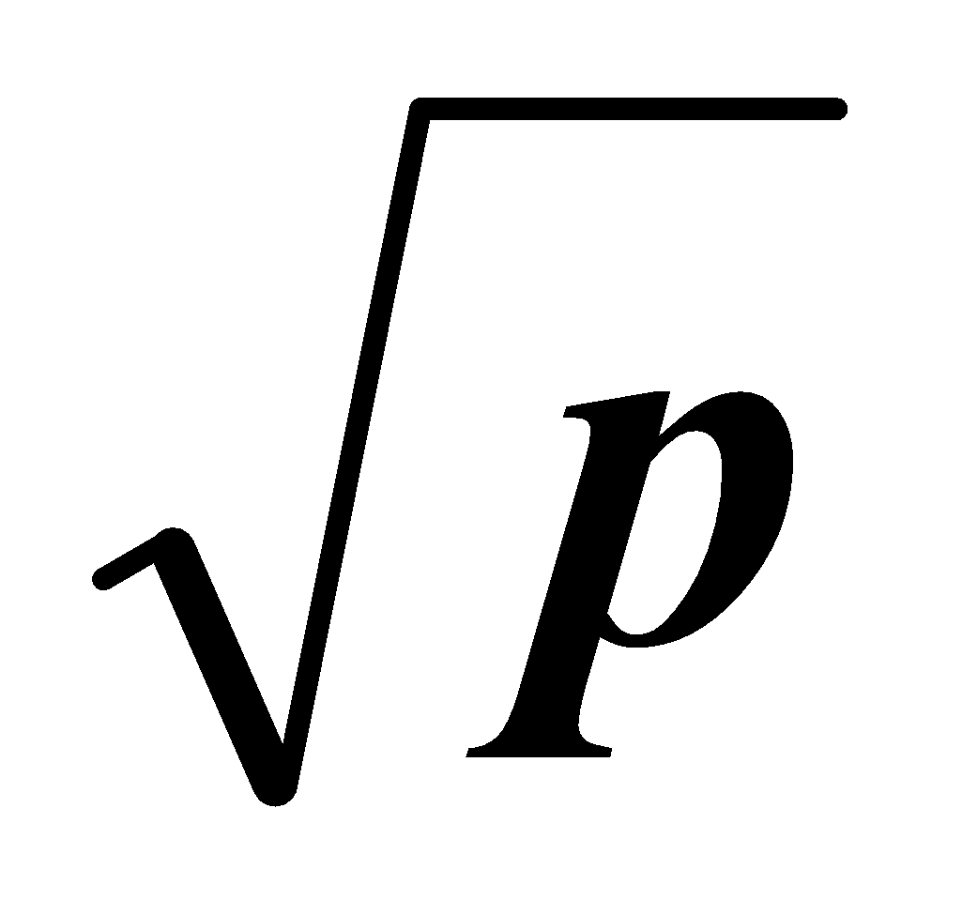
Security Aspects
Why are parameters signficantly smaller for elliptic curves (160-256 bit) than for RSA (1024-3076 bit)?
Attacks on groups of elliptic curves are weaker than available factoring algorithms or integer DL attacks
Best known attacks on elliptic curves (chosen according to cryptographic criterions) are the Baby-Step Giant-Step and Pollard-Rho method
Complexity of these methods: on average, roughly steps are required before the ECDLP can be successfully solved
Implications to practical parameter sizes for elliptic curves:
An elliptic curve using a prime p with 160 bit (and roughly 2¹⁶⁰ points) provides a security of 2⁸⁰ steps that required by an attacker (on average)
An elliptic curve using a prime p with 256 bit (roughly 2²⁵⁶ points) provides a security of 2¹²⁸ steps on average
‹#›/24
Chapter 9 of Understanding Cryptography by Christof Paar and Jan Pelzl

Slide 26
Lessons Learned
Elliptic Curve Cryptography (ECC) is based on the discrete logarithm problem. It requires, for instance, arithmetic modulo a prime.
ECC can be used for key exchange, for digital signatures and for encryption.
ECC provides the same level of security as RSA or discrete logarithm systems over Z_{p} with considerably shorter operands (approximately 160–256 bit vs. 1024–3072 bit), which results in shorter ciphertexts and signatures.
In many cases ECC has performance advantages over other public-key algorithms.
ECC is slowly gaining popularity in applications, compared to other public-key schemes, i.e., many new applications, especially on embedded platforms, make use of elliptic curve cryptography.
‹#›/24
Chapter 9 of Understanding Cryptography by Christof Paar and Jan Pelzl

